Slide 1
Design Studio
Experience @ Synaptics

Slide 2
Maintain and develop the major windows applications in Synaptics
Design Studio 5
Manipulate the touch chip through windows applications
Connection & power on/off
Reflash image file into chip
Export configuration from tool
Solution file create and manipulate
Including Production test
Capacitance Data observation and 2D finger observation.

Slide 3
Responsibility
DS4 | DS5 | DS6 | Customer issues | TSLite
Slim projects | LTDI LTS Wearable Proton | TDDI projects | All projects | LTS
DS4 3.5.5 DS4 3.5.6 DS4 4.1.0 | DS5 7.0.0 DS5 7.1.0 DS5 7.2.0 DS5 9.1.0 DS5 15.3.0 DS5 17.0.0 DS5 17.1.0 DS5 17.2.0 | DS6 1.0.0 | DS4/5 X.X.X | TSLite 2.3.0.0 TSLite 3.1.0.0

Slide 4
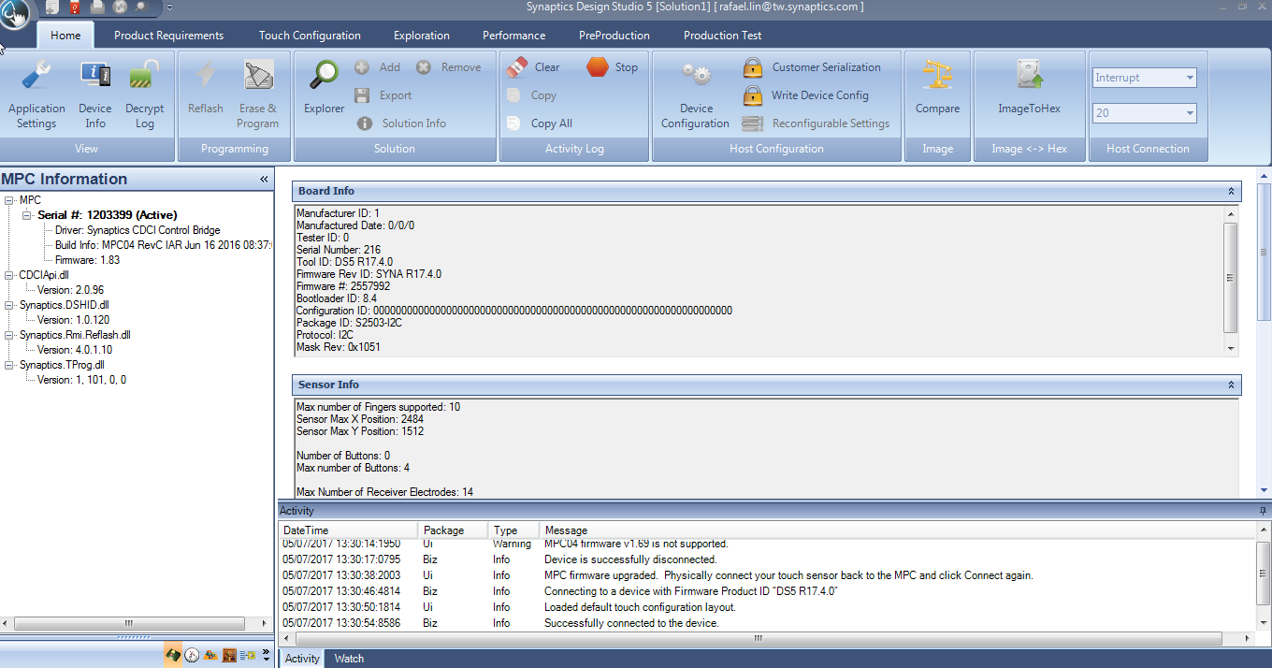
The exterior of the tool

Slide 5
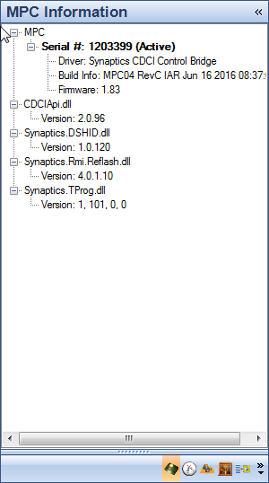
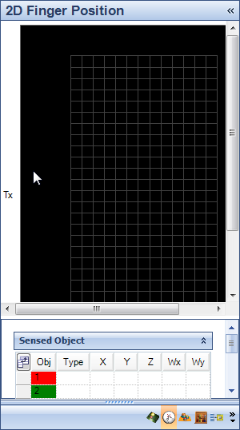
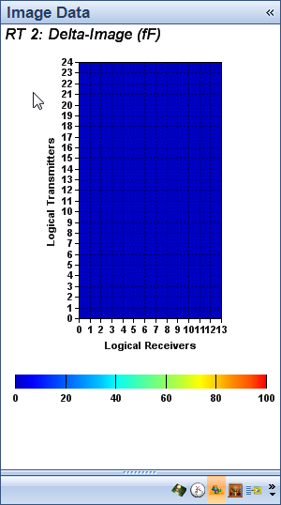
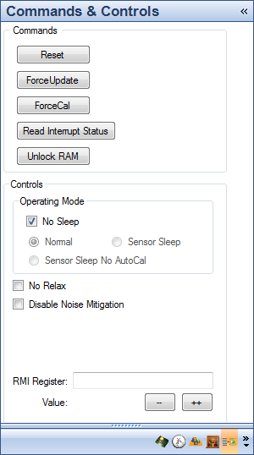
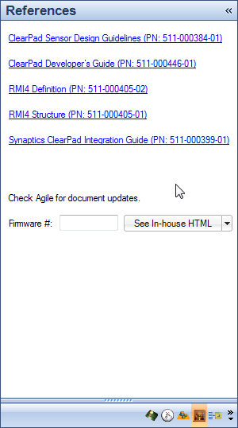
Control panel

Slide 6
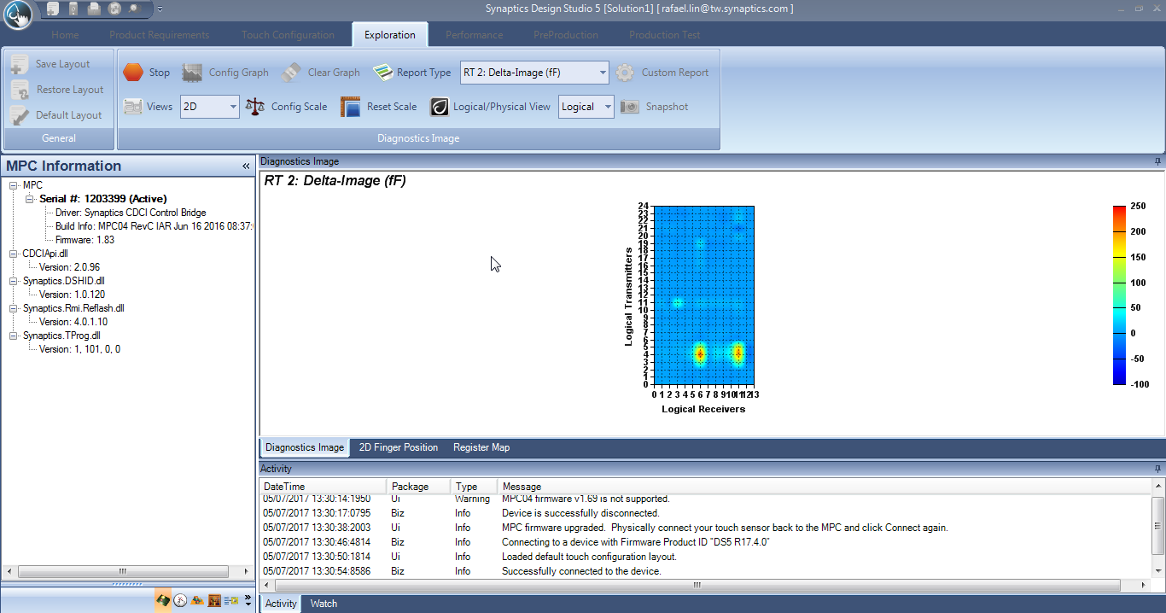
Raw Data Observation

Slide 7
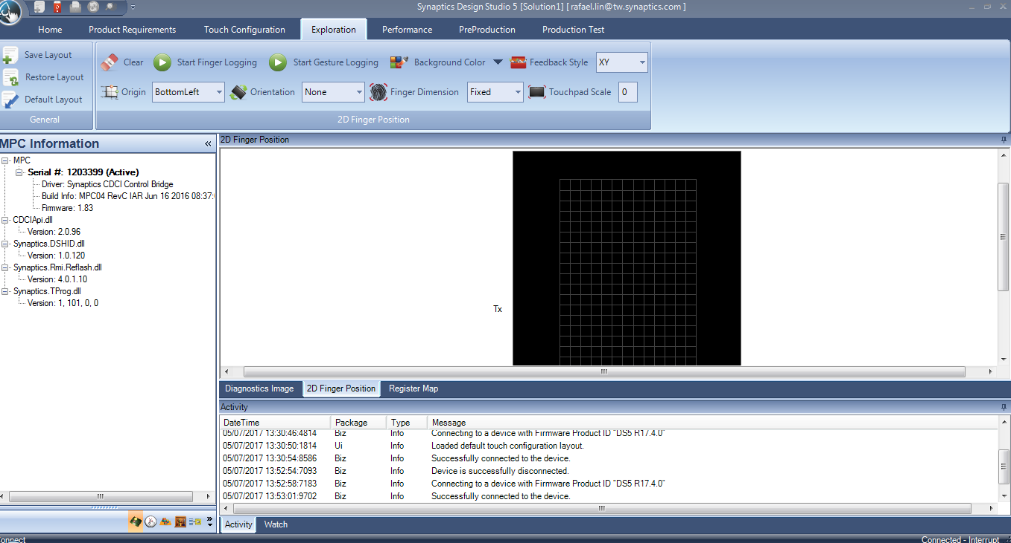
2D Finger position

Slide 8
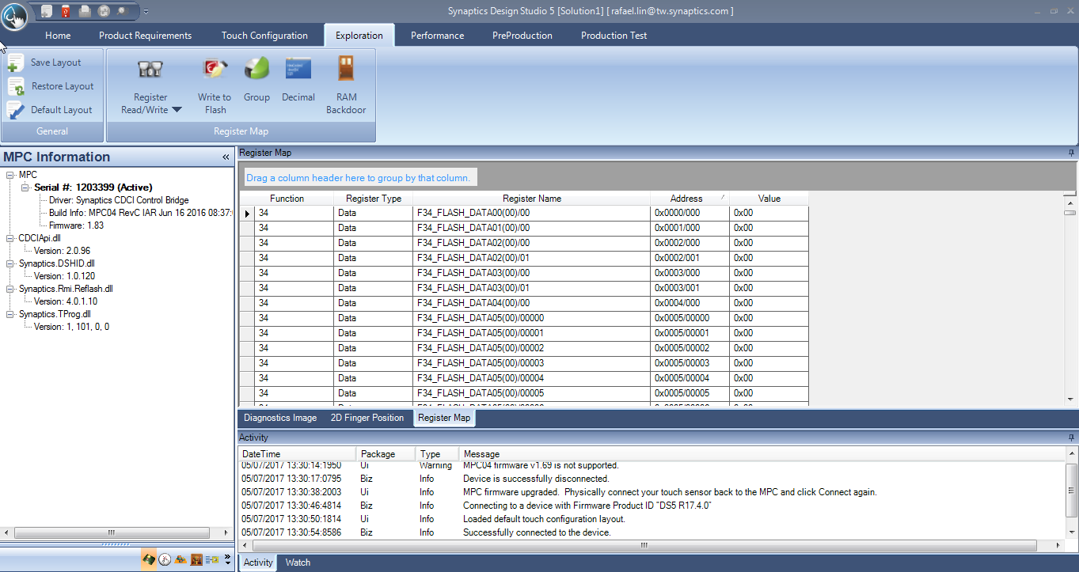
Register Map Read/Write

Slide 9
System Diagram
UI Layer
Business Layer
Communication Layer
I2C/SPI
CDCI API Library
MPC04 device
Touch chip

Slide 10
System Diagram
UI Layer
Business Layer
Communication Layer
Touch chip
Wifi
CDCI API Library
Android phone

Slide 11
System Diagram
UI Layer
Business Layer
Communication Layer
Touch chip
HID.dll
CDCI API Library
Notebook

Slide 12
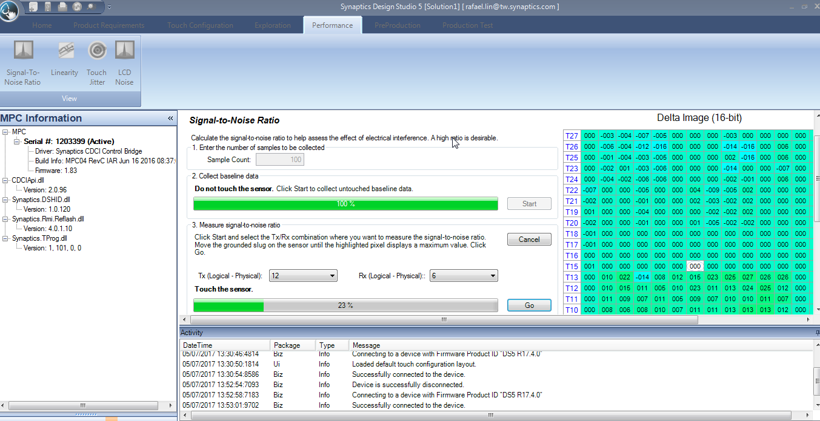
Performance linearity

Slide 13
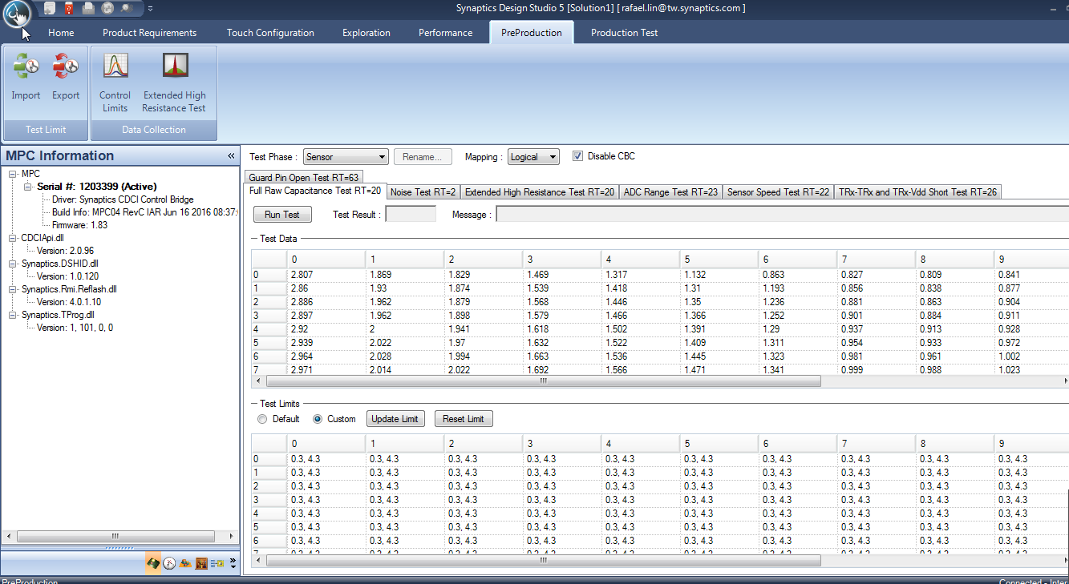
Preproduction

Slide 14
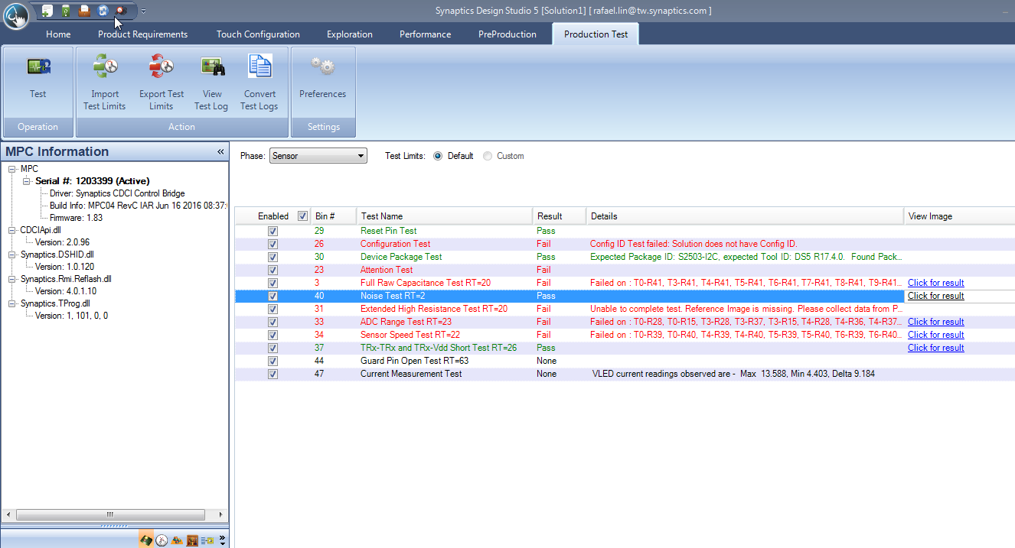
ProductionTest

Slide 15
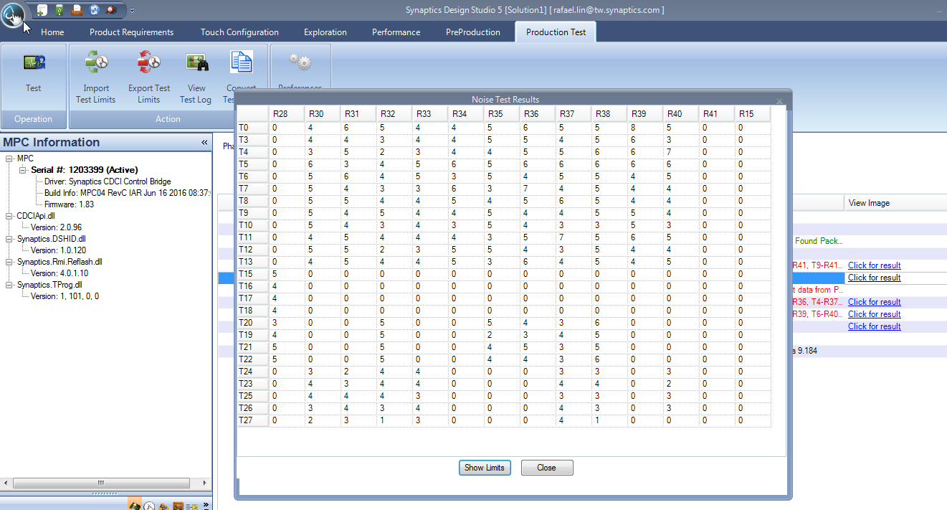
ProductionTest

Slide 16
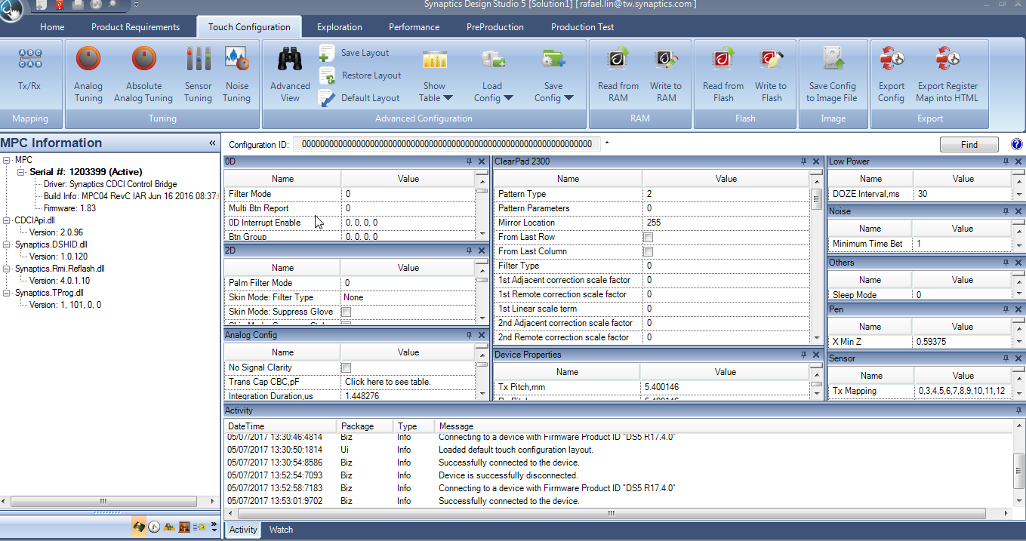
Touch Configuration – Advance View

Slide 17
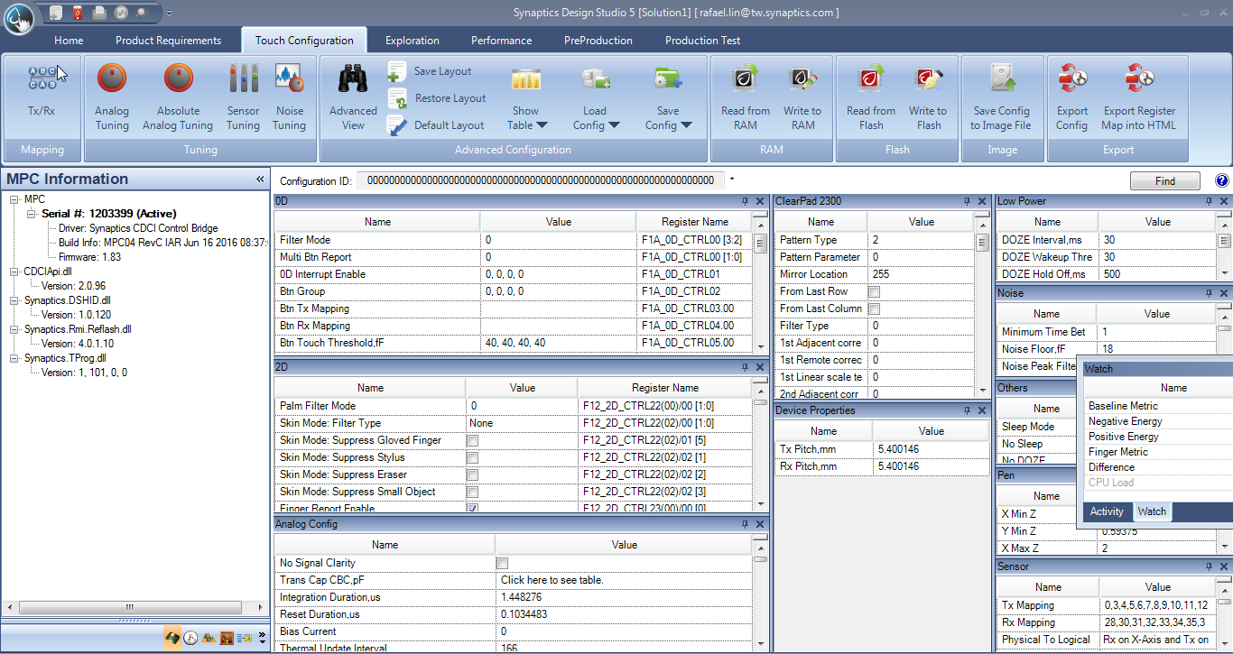
Advance View

Slide 18
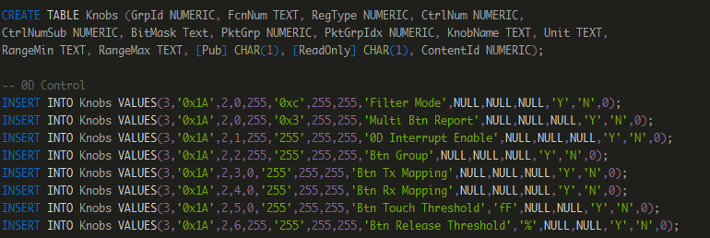
Advance View
How to create each knobs.
Load one knobs.sql
Based on the register address position, set/get the target value
Based on the table number, create one knobs on corresponding table
Show the correct name in accordance with that in knobs.sql

Slide 19
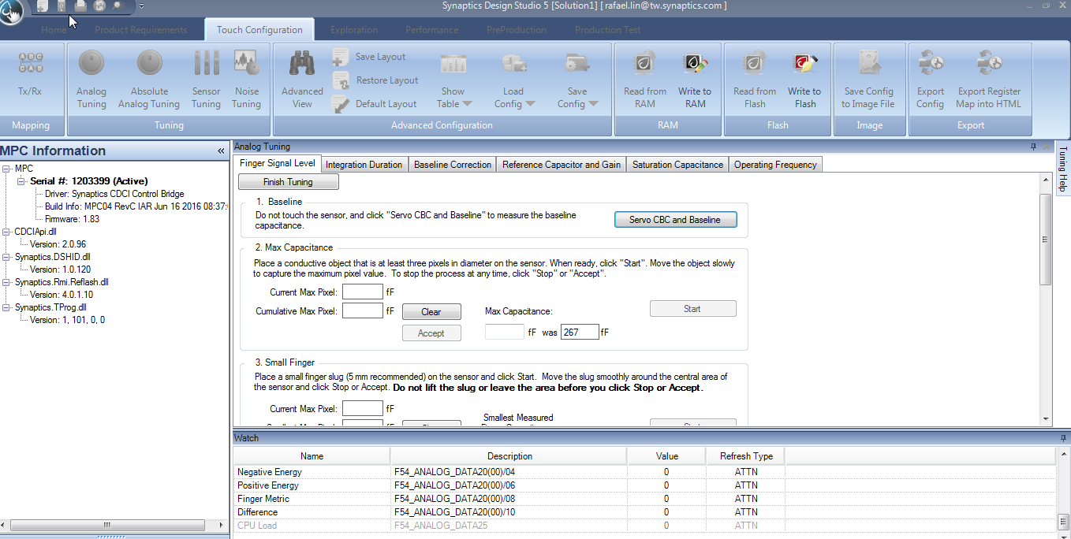

Slide 21
Several design pattern.
Factory
Singleton
Adaptor – ex
Observer – ex
Facade

